Slide 1
Data mining and data linking

Slide 2

Notes:
Publication is a closed object

Slide 3
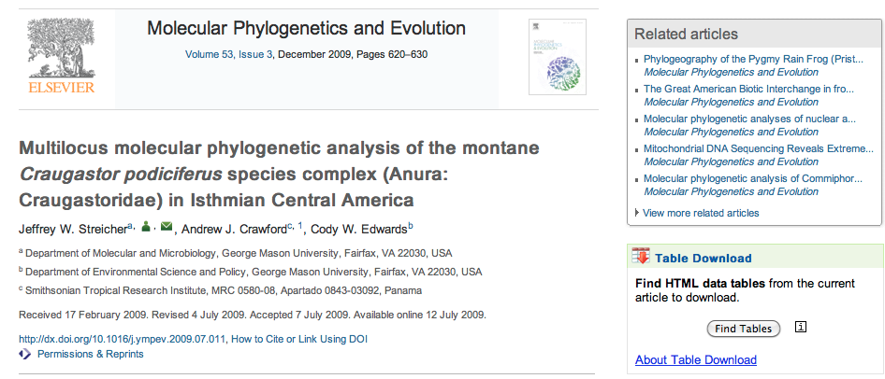
Getting data from papers (beyond the PDF)
http://dx.doi.org/10.1016/j.ympev.2009.07.011

Slide 4

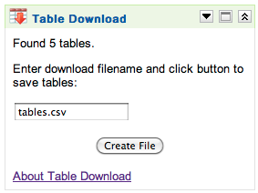
Extracting tables

Slide 5
Tables from paper as comma separated values (CSV)
Taxon and institutional vouchera,Locality ID,Collection locality,Geographic coordinates/approximate location,Elevation (m),GenBank accession number 12S,16S,COI,c-myc
1. UTA A-52449,1,"Puntarenas, CR","(10°18′N, 84°48′W)",1520,EF562312,EF562365,None,EF562417
2. MVZ 149813,2,"Puntarenas, CR","(10°18′N, 84°42′W)",1500,EF562319,EF562373,EF562386,EF562430
3. FMNH 257669,1,"Puntarenas, CR","(10°18′N, 84°47′W)",1500,EF562320,EF562372,EF562380,EF562432
4. FMNH 257670,1,"Puntarenas, CR","(10°18′N, 84°47′W)",1500,EF562317,EF562336,EF562376,EF562421
5. FMNH 257671,1,"Puntarenas, CR","(10°18′N, 84°47′W)",1500,EF562314,EF562374,EF562409,None
6. FMNH 257672,1,"Puntarenas, CR","(10°18′N, 84°47′W)",1500,EF562318,None,EF562382,None

Slide 6
Cleaning data

Slide 7
(10°18’N, 84°42’W)
2. MVZ 149813,2,"Puntarenas, CR","(10°18′N, 84°42′W)",1500,EF562319,EF562373,EF562386,EF562430
We can read this, but a computer would prefer just numbers

Slide 8

Tools for cleaning data
Spreadsheets like Excel and Google Docs can be used to clean data using simple formula (such as combining cells)
Google Refine offers regular expressions, filtering, and the ability to call external services

Slide 9
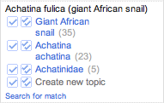
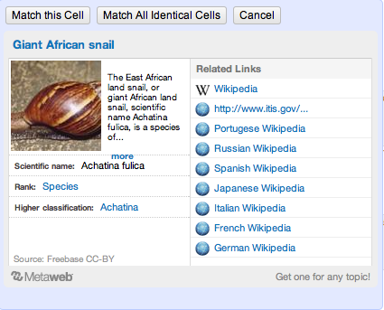
Achatina fulica (giant African snail)

Slide 10
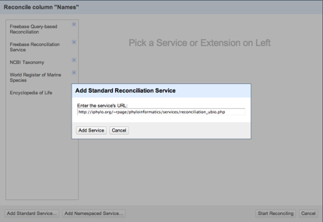
Reconciliation services
By default Google Refine uses Freebase
But we can add our own services…

Slide 11
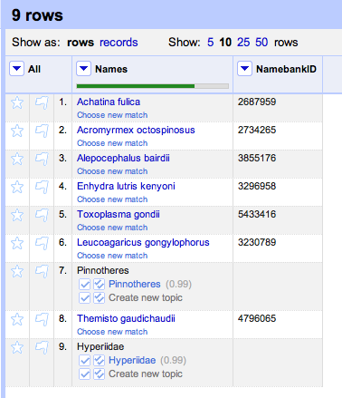
Names reconciled using uBio and Google Refine

Slide 12
What can we do with data mining?

Slide 13
Extract information on ecological relationships

Slide 14
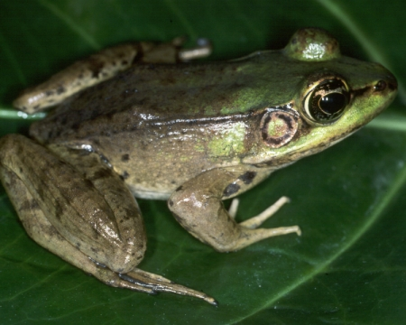

Slide 15
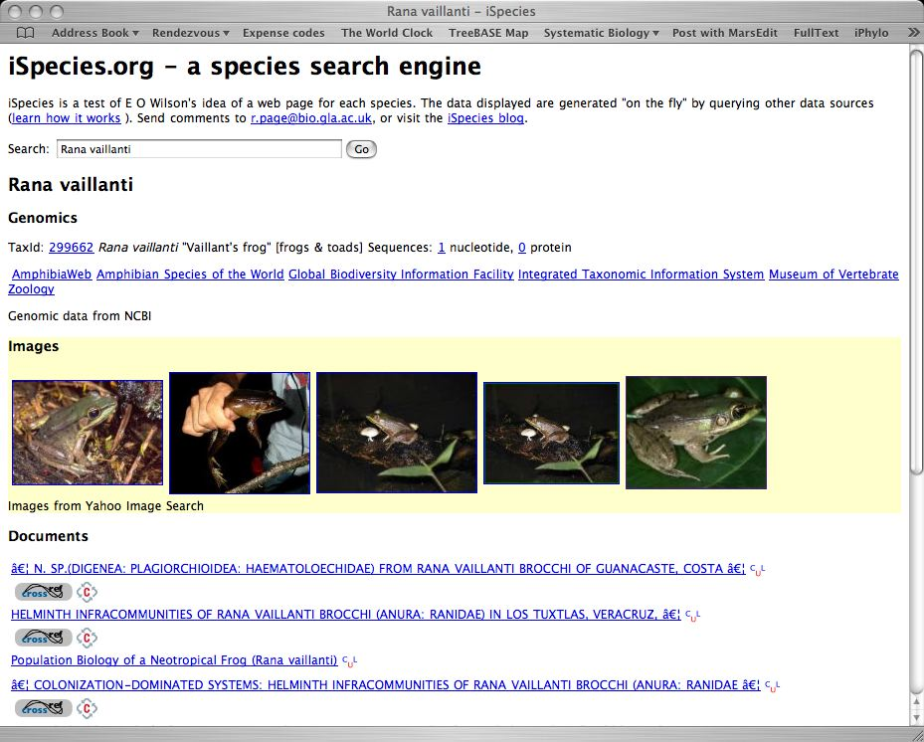
Text mining

Slide 16
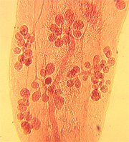
Morphological and molecular description of Haematoloechus meridionalis n. sp. (Digenea: Plagiorchioidea: Haematoloechidae) from Rana vaillanti brocchi of Guanacaste, Costa Rica
Halipegus eschi n. sp. (Digenea: Hemiuridae) in Rana vaillanti from Guanacaste Province, Costa Rica
Haematoloechus danbrooksi n. sp. (Digenea: Plagiorchioidea) from Rana vaillanti from Los Tuxtlas, Veracruz, Mexico

Slide 17
<parasite name> (n. sp.) from <host name>

Slide 18
Sources of host-parasite associations
Titles of papers
Sequence databased (GenBank)

Slide 19
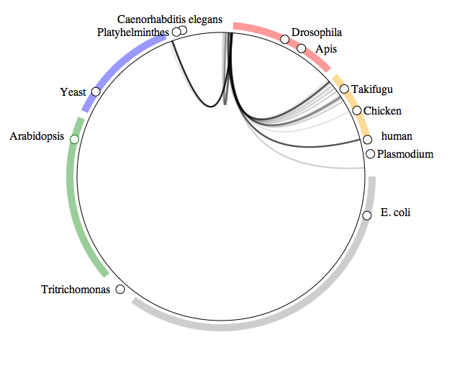
What do crustaceans live on?
Arthropods
Fungi
Vertebrates
Green
plants
Bacteria

Slide 20
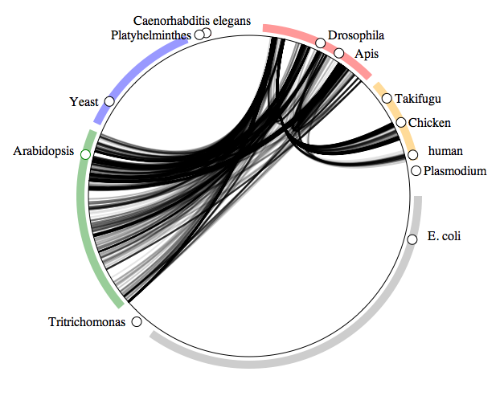
What do insects live on?
Arthropods
Fungi
Vertebrates
Green
plants
Bacteria

Slide 21
Host names in GenBank
acorn gall on Quercus pyrenaica
Aconitum napellus
Aconitum napellus L.
Acinonyx jubatus (Cheetah)
Actinidia chinensis Hort 16A
Alces alces (intermediate host)
alfalfa

Slide 22
Extracting links between data sets

Slide 23

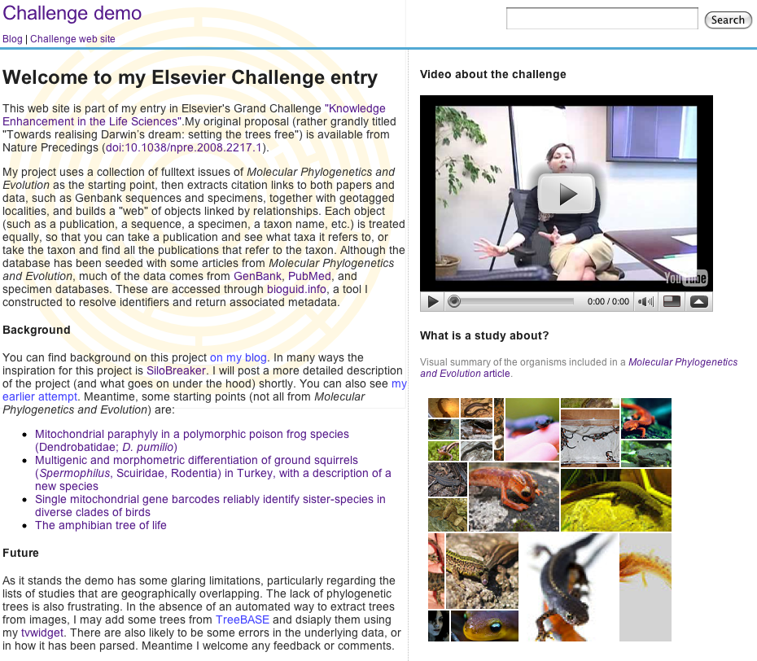
http://iphylo.org/~rpage/challenge

Slide 24
Notes:
Publication is a closed object

Slide 25
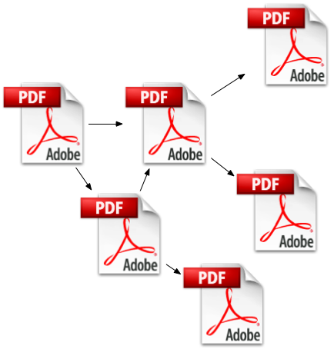
Citation links
Notes:
All the same thing

Slide 26
Are there other kinds of links?

Slide 27
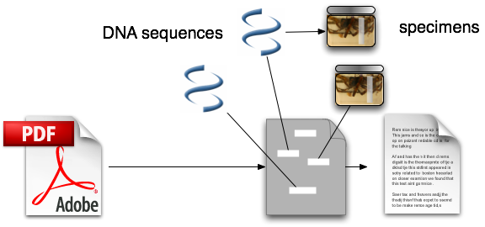
data linking
Notes:
Citation, user sees bibliography and may be able to follow links

Slide 28
Extracting these links
Look for Genbank sequences
Look for specimen identifiers
Look for taxonomic names
Look for geographic localities

Slide 29
Regular expressions to the rescue!

Slide 30
Regular expressions
Rules for matching strings
Allow for approximate or variable matches
More flexible than “search and replace”
[0-9]{4} matches a string with four digits (such as a year)

Slide 31
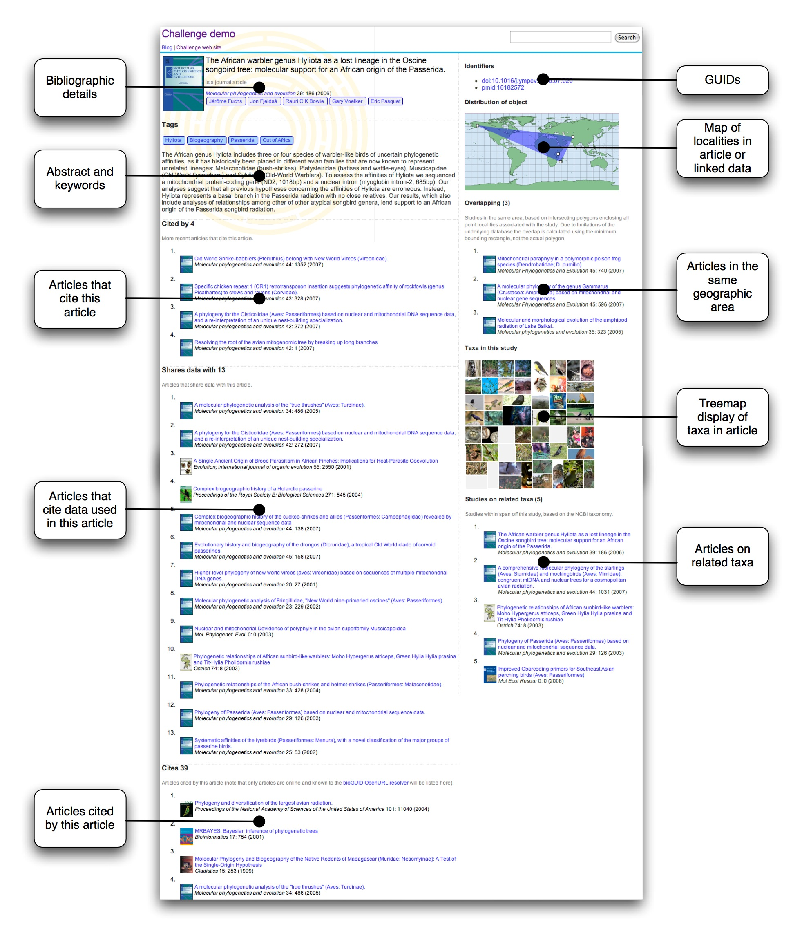
demo

Slide 32
Perils of data mining
(matching the wrong things)

Slide 33
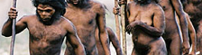

Taxa found in one paper
Image search on taxonomic name

Slide 34
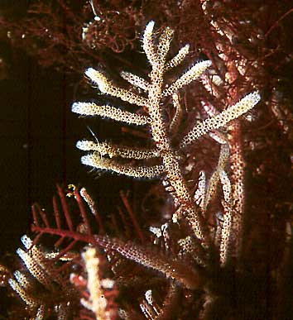
Electra pilosa

Slide 35
Carmen Electra versus Electra
(guess which one is more popular?)

Slide 36
But what about this?

Slide 37
Homo sapiens

Slide 38
AJ711044

Slide 39
should be AJ971044

Slide 40
Error in paper lead to wrong image
How do I fix this error in the paper?

Slide 41
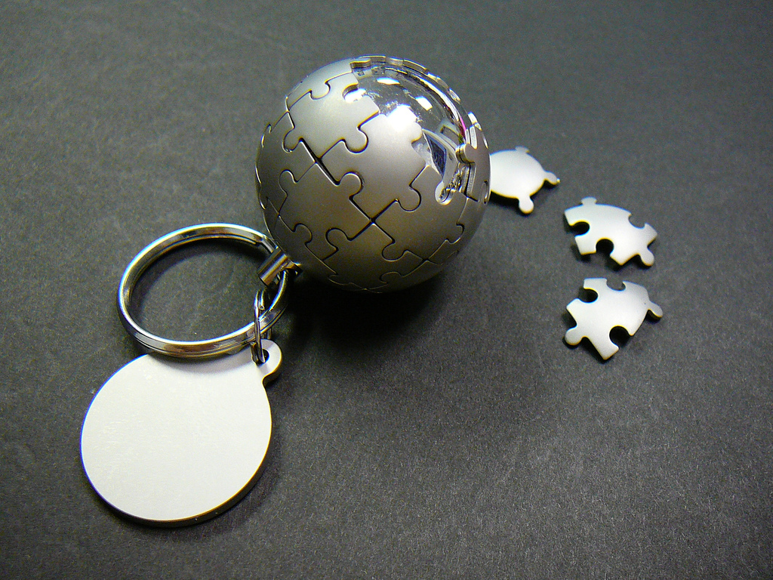
Wikis
Notes:
http://www.flickr.com/photos/bastique/639784702/ by bastique

Slide 42
Is there a better way to make these links?
(what if they were made for us?)

Slide 43
Digital Object Identifier (DOI)

Slide 44


Slide 45
Identifies a publication

Slide 46
Globally unique

Slide 47
10.1016/j.ympev.2006.04.006

Slide 48
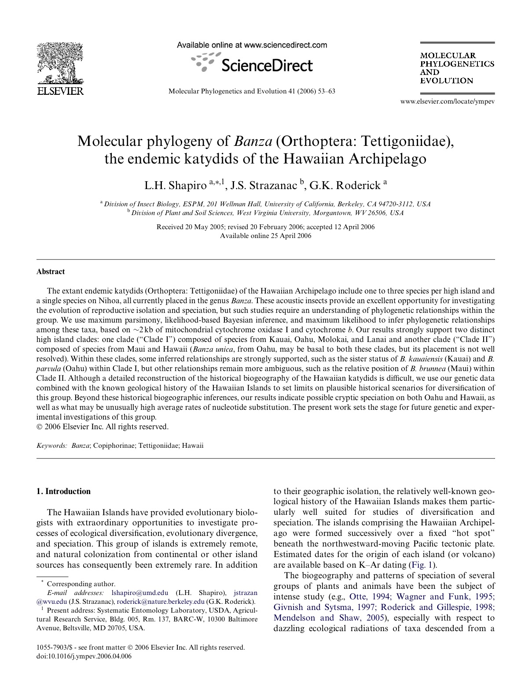
Paper

Slide 49
Why have DOIs?

Slide 50
Link rot

Slide 51
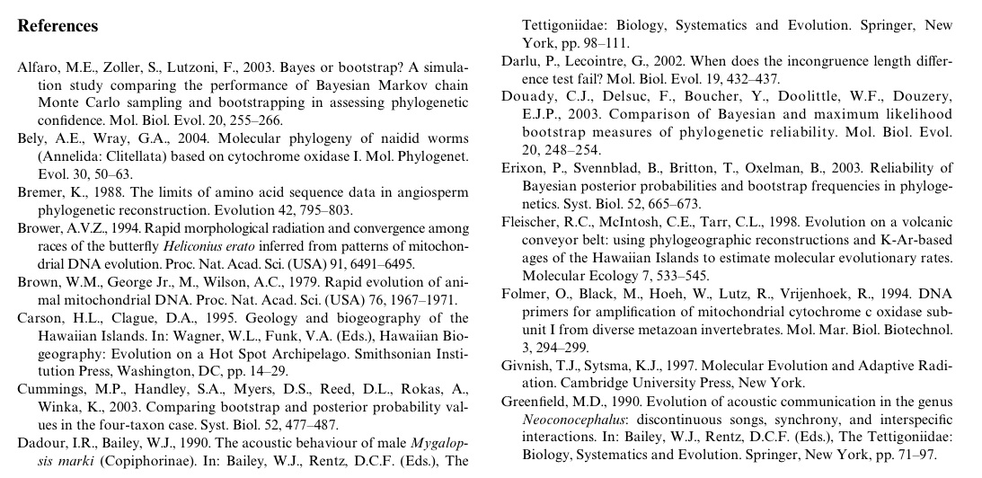
Refs

Slide 52





Slide 53


Slide 54
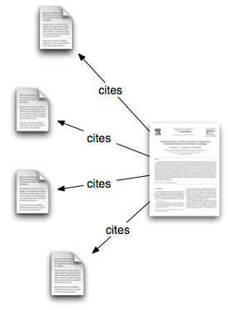
Cites
2006
2006

Slide 55
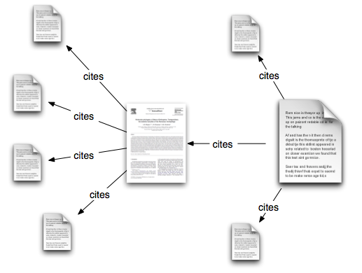
Forward Cites
2006
2009

Slide 56
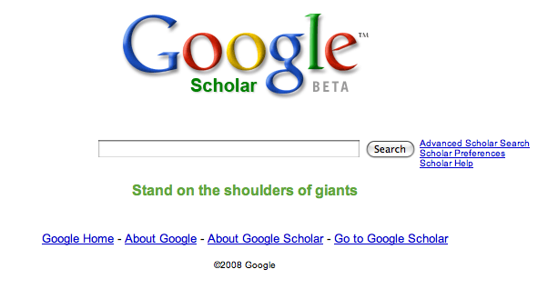
Shoulders of giants

Slide 57
progress is incremental

Slide 58
reuse past results

Slide 59
Forward Cites
2006
2008

Slide 60
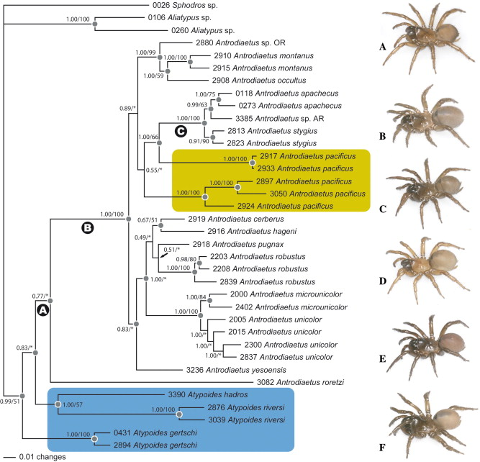
Notes:
~/Desktop/GrandChallenge/Data/DVD/LAB0370A/10557903/00420003/06003691/main.xml

Slide 61
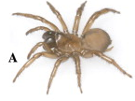

Species
Genes

Slide 62
data linking
Notes:
Citation, user sees bibliography and may be able to follow links

Slide 63
Data citation

Slide 64
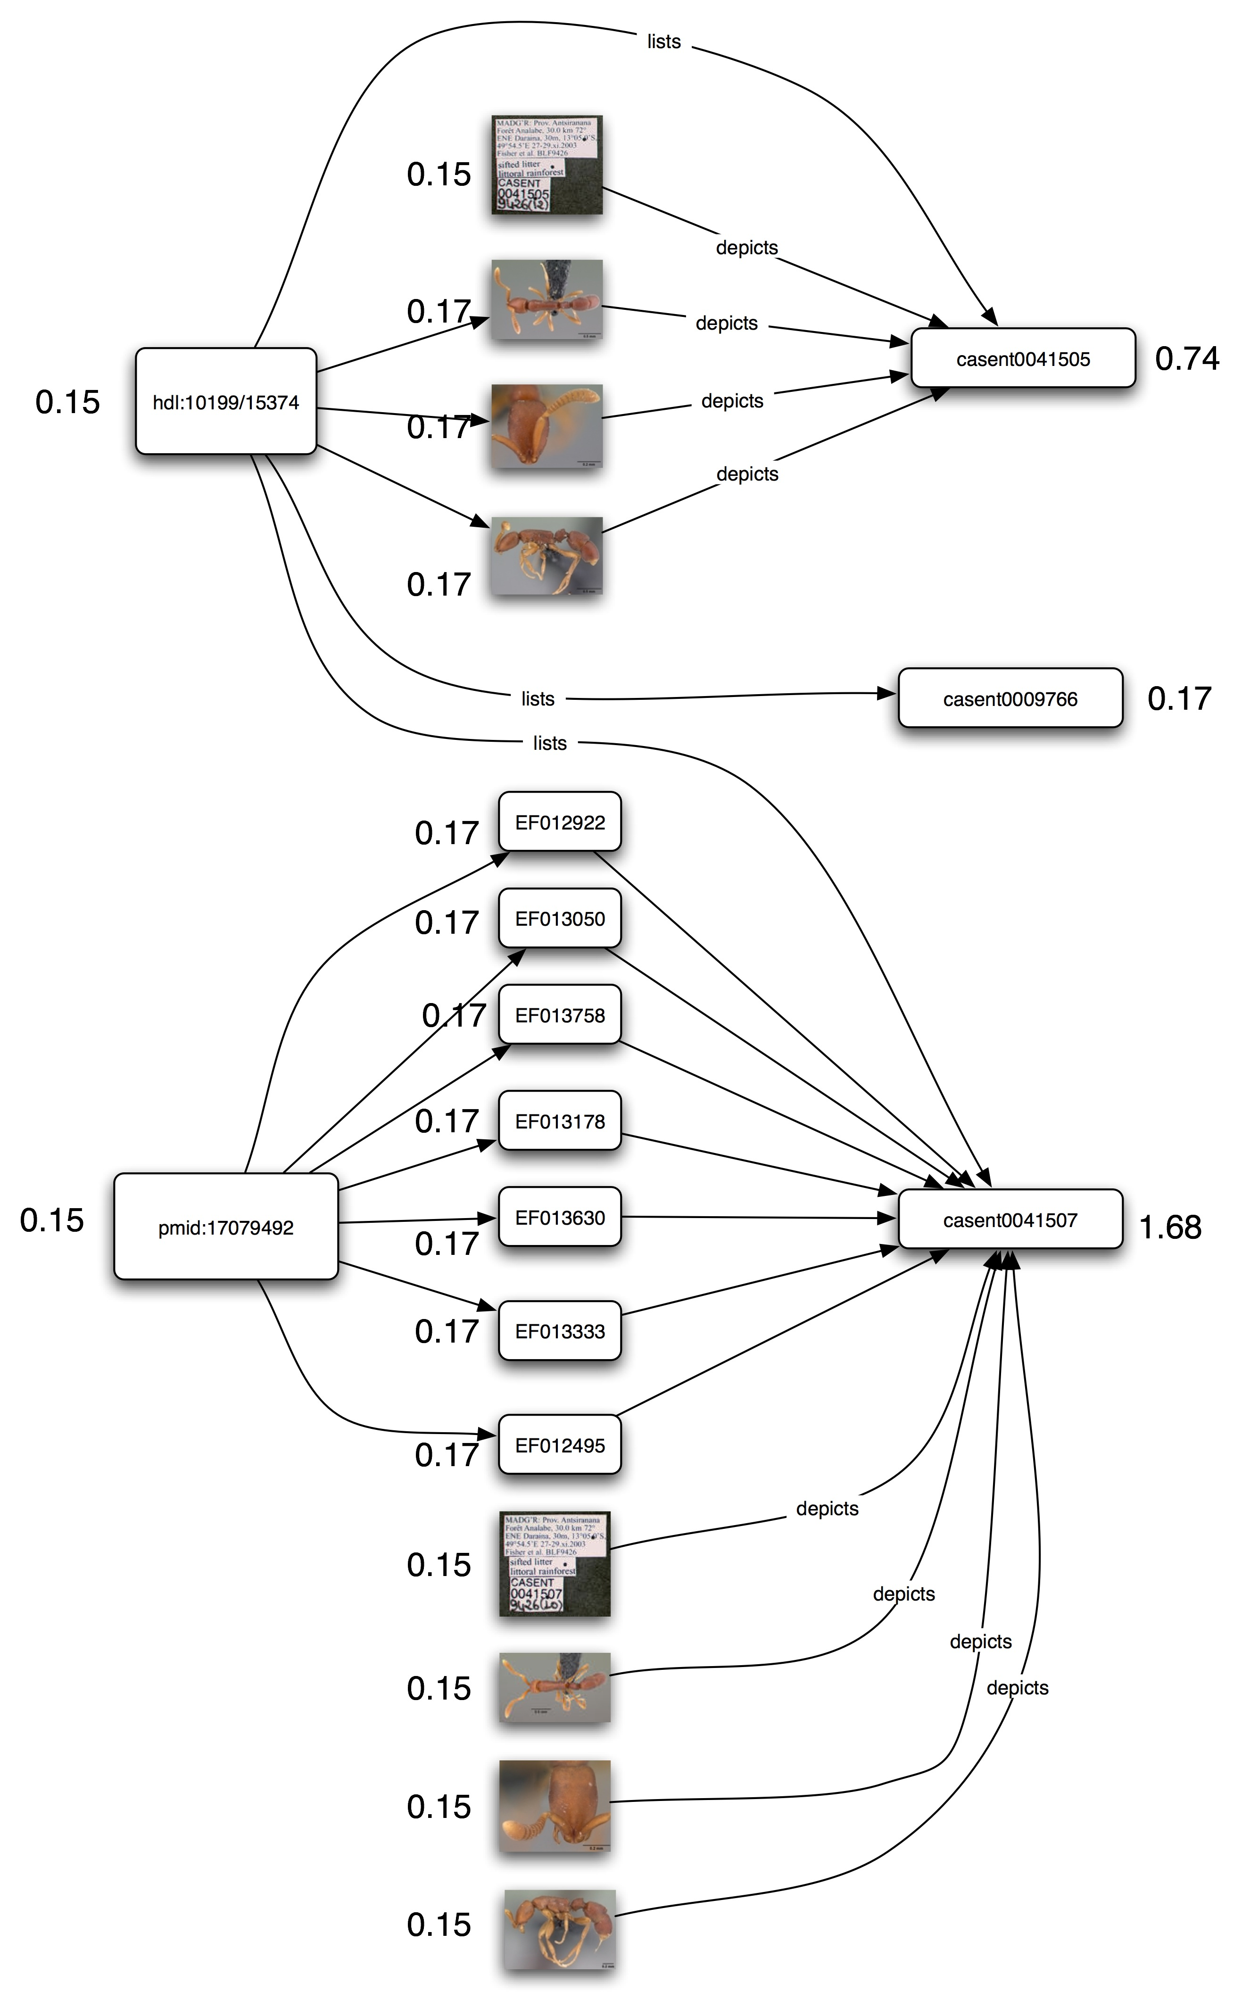
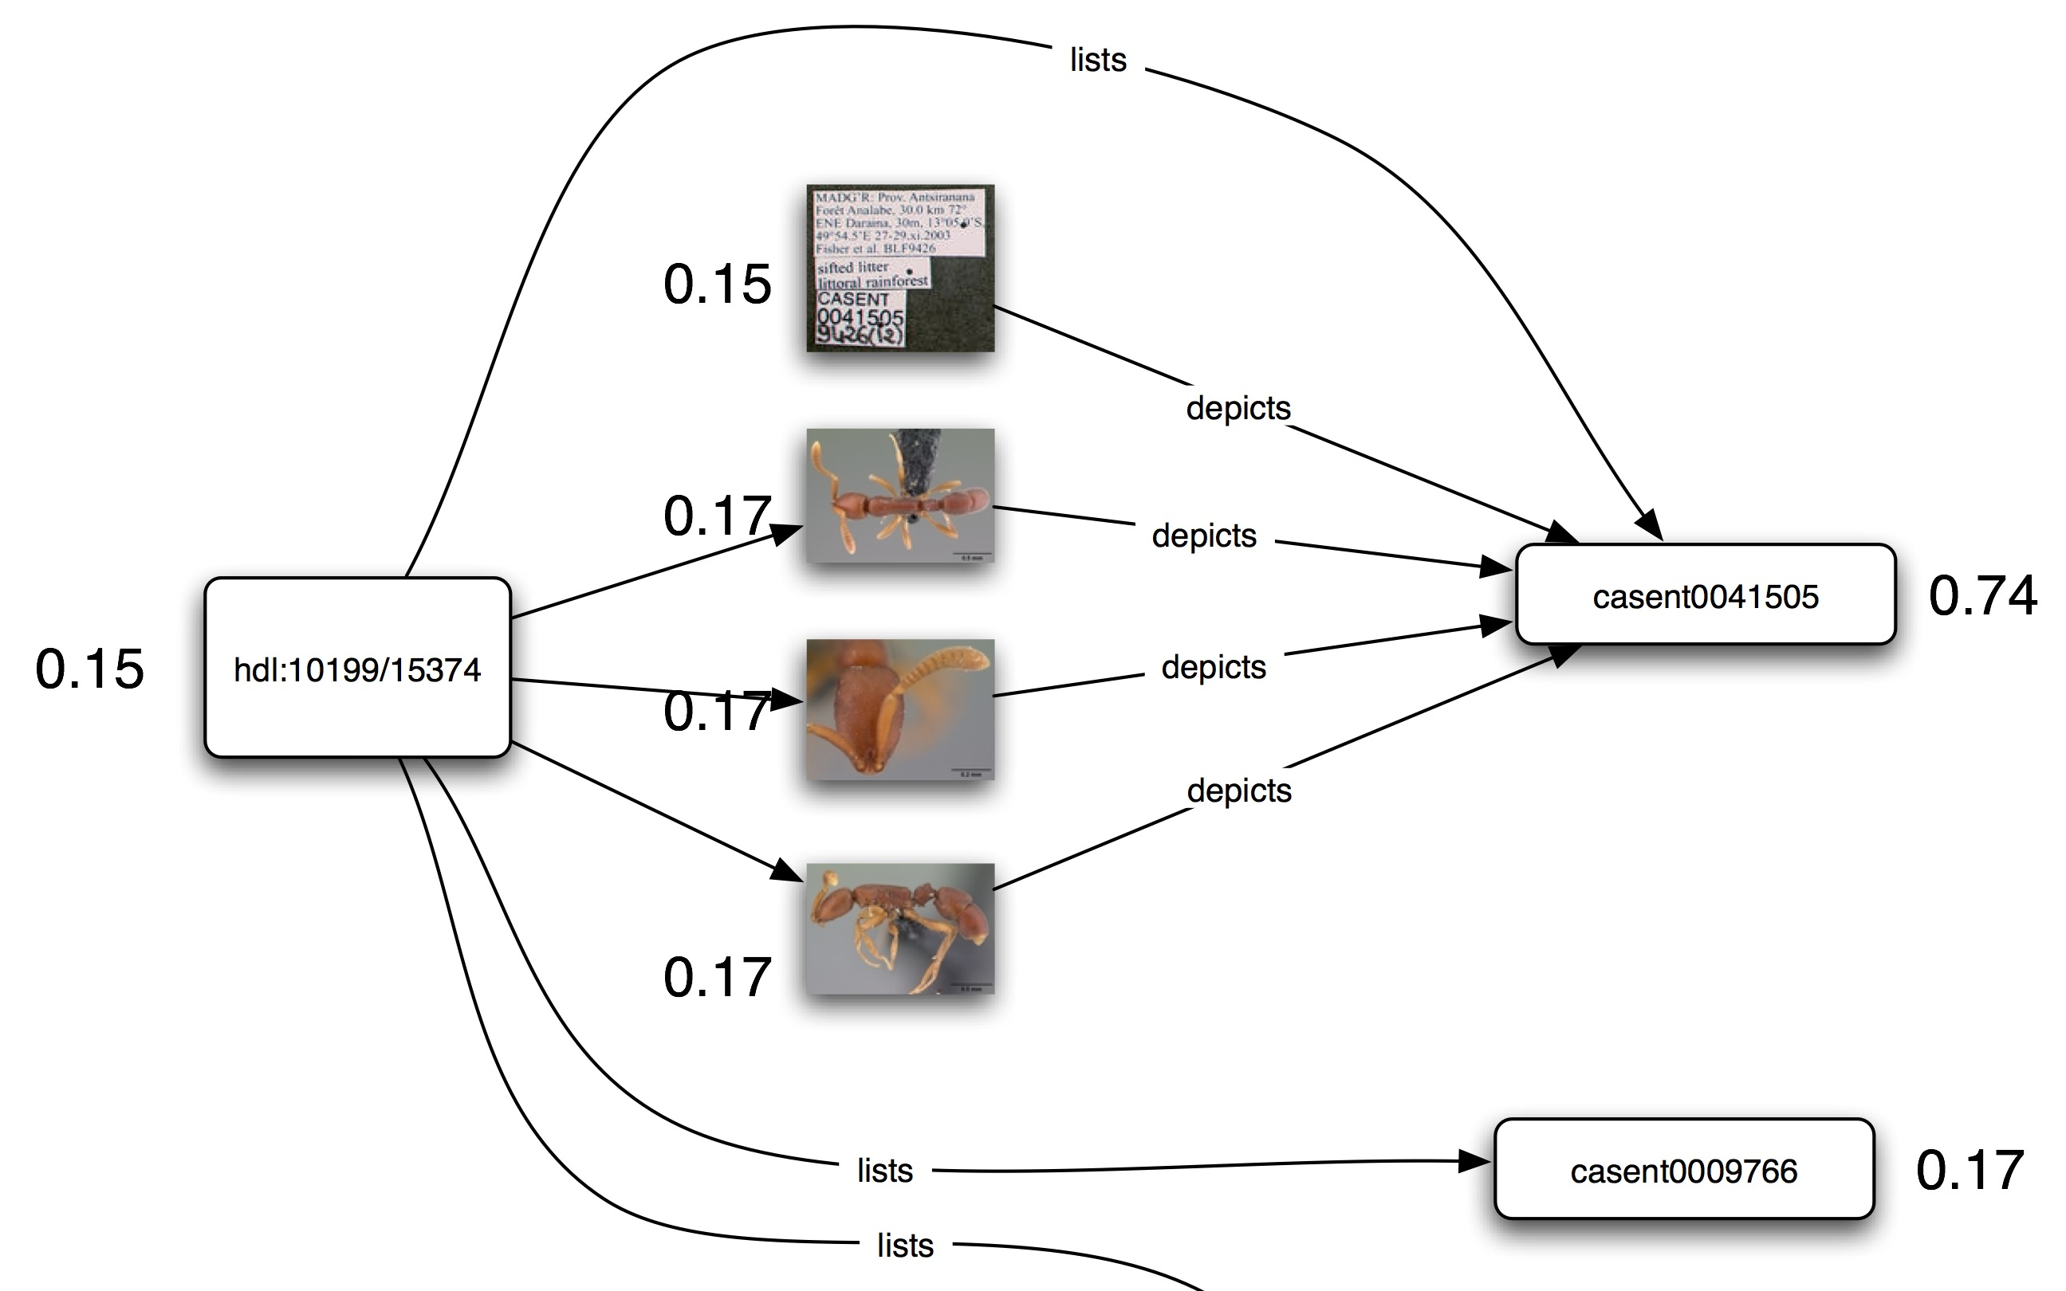
Notes:
Data citation with PageRank scores

Slide 65
Linked data
Use same, globally unique identifiers for same thing (e.g., use DOI for a paper)
Identifier can be resolved (put it in a browser and get something back)
Use the same terms to describe the same thing

Slide 66
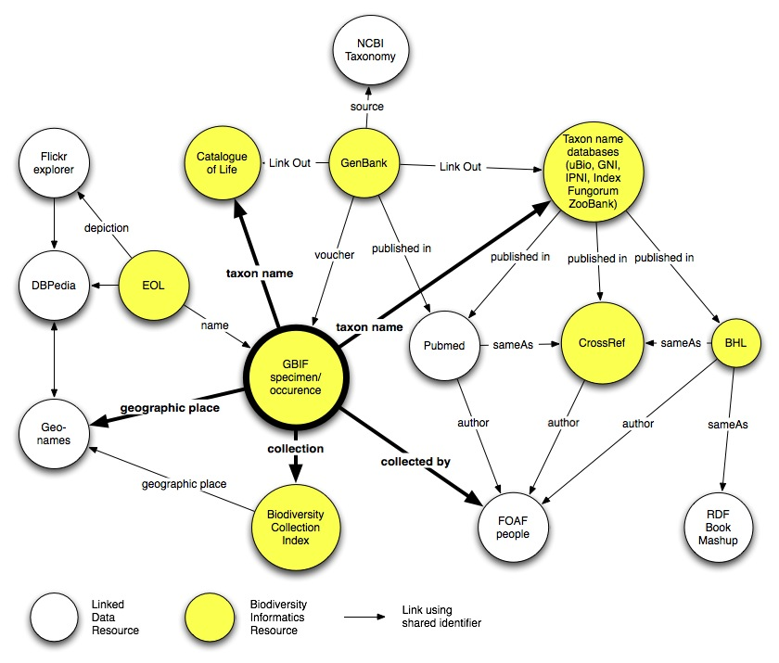

Slide 67
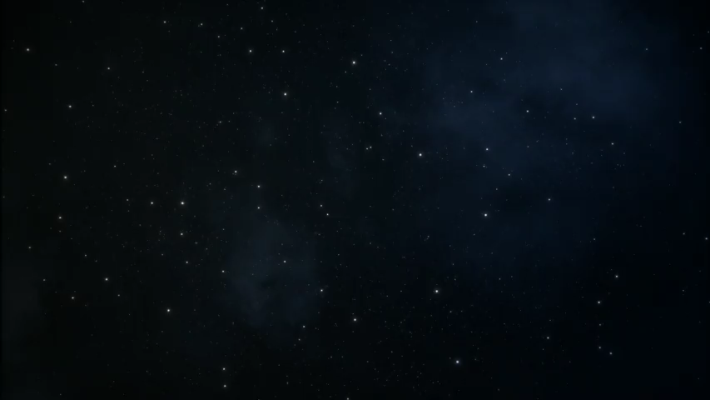

Slide 68
What does the future hold?
Identifiers for data (as well as papers)?
Citation metrics for data?
Regular expressions become less important (wishful thinking?)
Wikification of articles (post-publication commentary and edits)
Linked data (problem is lack of links)

